Slide 1
Environmental stress in the Industrial area &
Accidents
Dr.Doss Prakash S
Professor & Head
Dept of Community Physiotherapy
MGMIOP

Slide 2


Slide 3


Slide 4


Slide 5
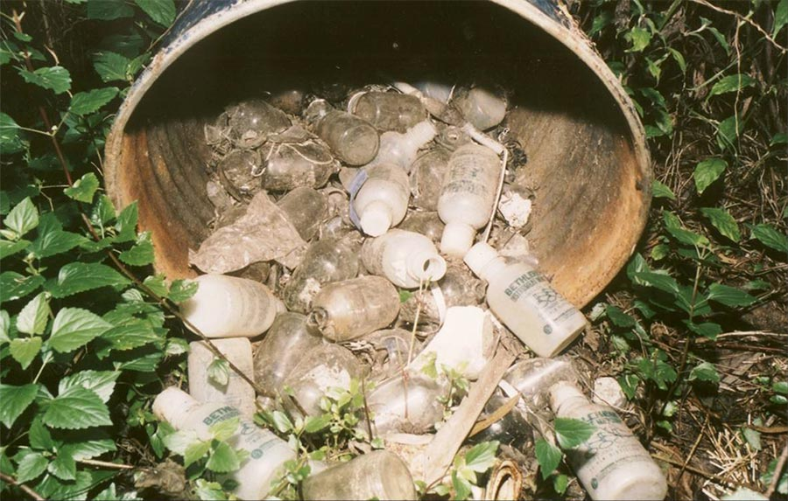

Slide 6
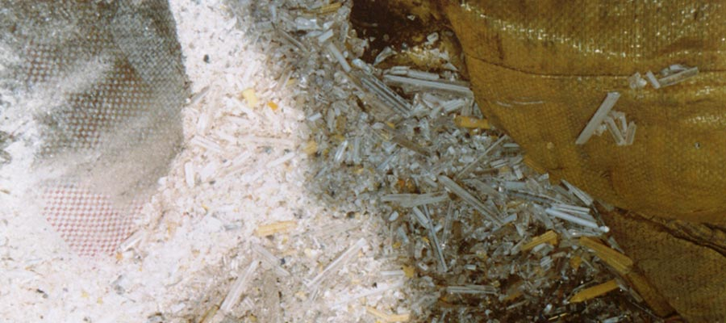

Slide 7


Slide 8
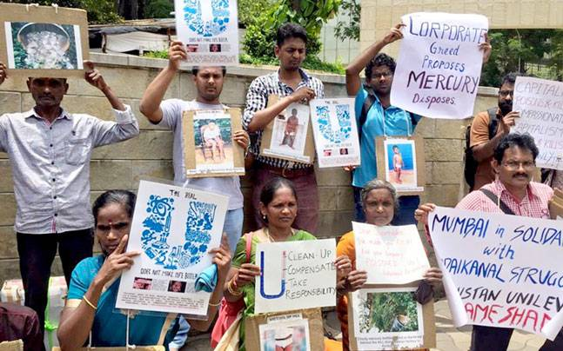

Slide 9
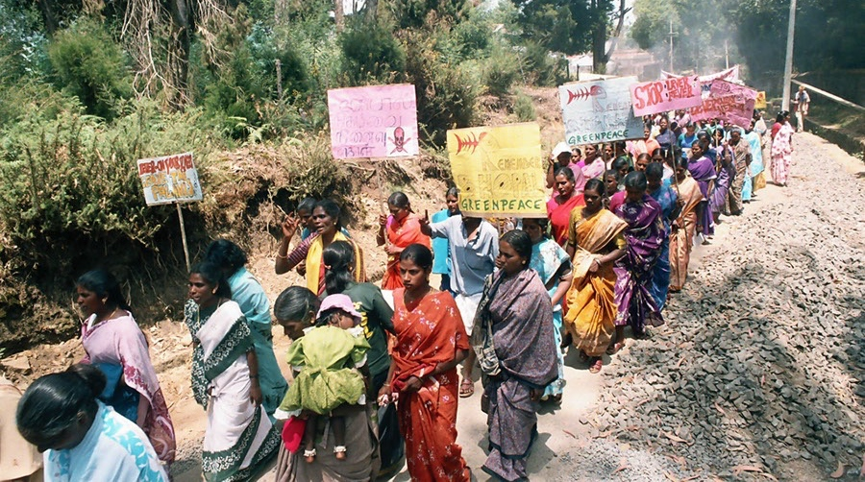

Slide 10


Slide 11
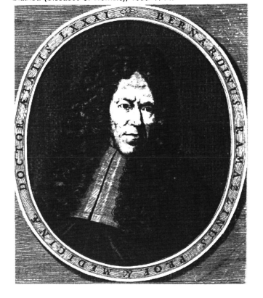
Bernardino Ramazzini
Italian medical professor
Father of Occupational Medicine
De Morbis Artificum Diatriba
[Diseases of Workers]

Slide 12
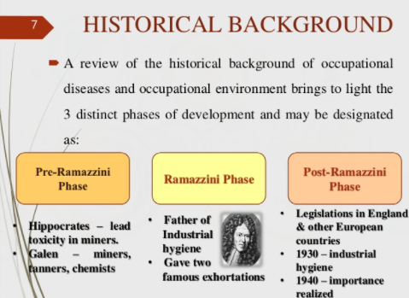

Slide 13
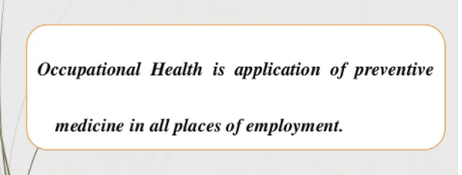

Slide 14
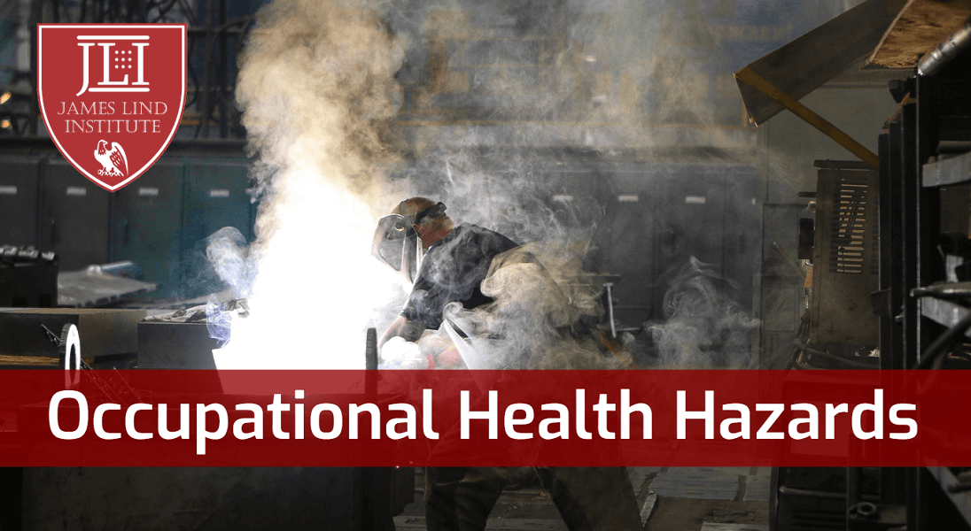

Slide 15
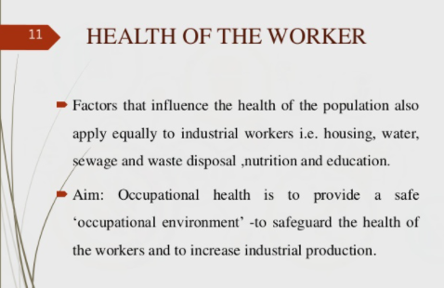

Slide 16
Occupational Environment (OE)
OE
Man Vs Agents
Man Vs Machine
Man vs Man

Slide 17
Occupational Hazards by Agents
Hazards
Physical
Chemical
Mechanical
Psychosocial
Biological

Slide 18
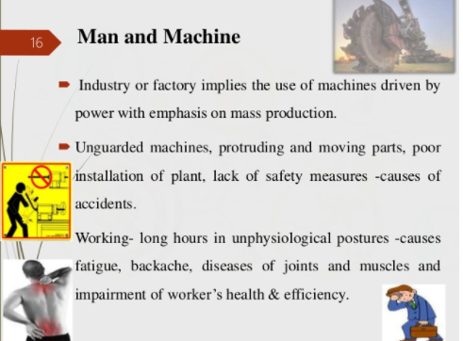
Occupational Hazards by Man vs Machine

Slide 19
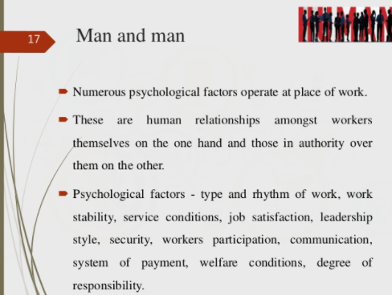
Occupational Hazards by Man vs Man

Slide 20
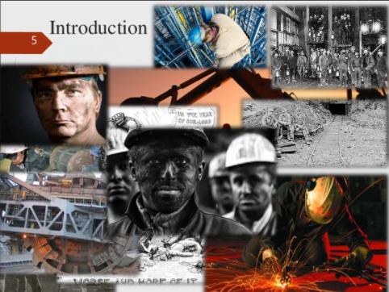

Slide 21
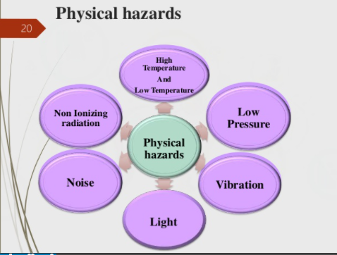

Slide 22
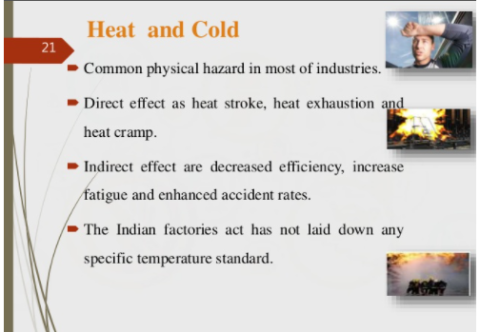

Slide 23
Many industries have local hot spots, ovens and furnaces which radiate heat.
Radiant heat is the main problem in foundry, glass and steel industries.
Heat stagnation is the main problem in jute and cotton textile industries.
High temperatures are also found at mines for instance in gold mines which is the second deepest mine in the world, temperatures as high as 150 deg F are recorded.
Temperatures of 69 to 80 deg F is the comfort zone in this country, temperatures above 80 deg F causes discomfort.

Slide 24
Miners Cramp
Heat exhaustion - thirst, fatigue, giddiness, and often muscle cramps; fainting can also occur.
Heat Stroke a more serious and sometimes lethal condition
Prolonged exposure to heat and high humidity prevents efficient perspiration (by preventing evaporation of sweat), causing the body temperature to rise above 106° F (41° C) and the skin to feel hot and dry.
If victims are not quickly cooled down, coma, convulsions, and death can follow.
To prevent heat exhaustion or heatstroke, workers unaccustomed to high temperatures should allow adequate time (ranging from days to weeks) for their bodies to become acclimatized before performing strenuous physical tasks.

Slide 25
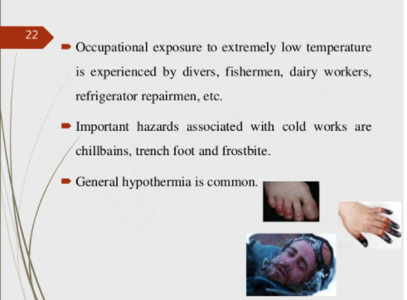

Slide 26
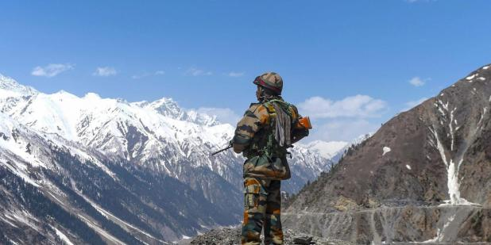
Extreme Cold climatic conditions

Slide 27
Work in cold environments may also have serious adverse effects.
Tissue damage that does not involve freezing can cause inflammatory swelling known as chilblains.
Frostbite, or the freezing of tissue, can lead to gangrene and the loss of fingers or toes.
If exposure is prolonged , critical fall in body temperature, may result. When body temperature falls below 95° F (35° C), physiological processes are slowed, consciousness is impaired, and coma, cardiorespiratory failure, and death may ensue.
Workers exposed to extreme cold require carefully designed protective clothing to minimize heat loss, even though a degree of acclimatization occurs with time.

Slide 28
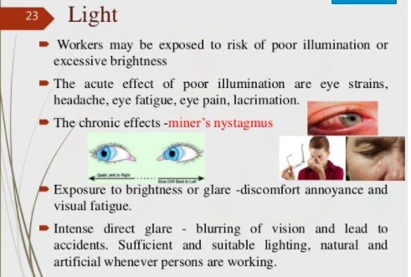

Slide 29
Noise
Exposure to excessive noise can be unpleasant and can impair working efficiency.
Temporary or permanent hearing loss may also occur, depending on the loudness or intensity of the noise, its pitch or frequency, the length and pattern of exposure, and the vulnerability of the individual.
Prolonged exposure to sound energy of intensity above 80 to 90 decibels is likely to result in noise-induced hearing loss
NON AUDITORY EFFECTS: Nervousness, fatigue, interference with communication by speech, decreased efficiency.

Slide 30
The condition can be prevented by enclosing noisy machinery and by providing effective ear protection.
Routine audiometry gives an indication of the effectiveness of preventive measures.

Slide 31
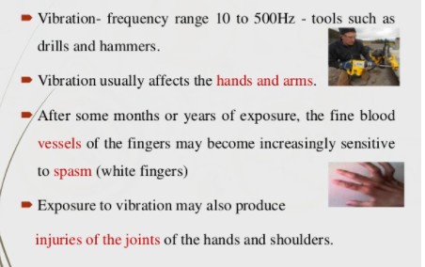
Vibration

Slide 32
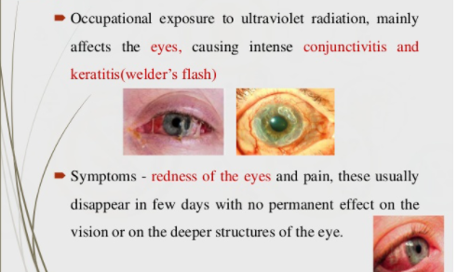
Ultraviolet Radiation
Occurs mainly in arc welding

Slide 33
Ionizing radiation
Ionizing radiation damages or destroys body tissues by breaking down the molecules in the tissues into positively or negatively charged particles called ions.
Radiation that is capable of causing ionization may be electromagnetic (X rays and gamma rays) or particulate (radiation of electrons, protons, neutrons, alpha particles, and other subatomic particles) and has many uses in industry, medicine, and scientific research.

Slide 34
Ionizing radiation injury is in general dose-dependent.
Whole-body exposure to doses in excess of 1,000 rads results in acute radiation syndrome and is usually fatal.
Doses in excess of 3,000 rads produce cerebral edema (brain swelling) within a matter of minutes, and death within days.
Lesser doses cause acute gastrointestinal symptoms, such as severe vomiting and diarrhea, followed by fever, ulceration of the mouth and throat, hemorrhages, and hair loss.
There is an immediate drop in the white-cell elements of the blood, affecting the lymphocytes first and then the granulocytes and platelets, with a slower decline in the red cells.

Slide 35
Delayed effects of exposure to radiation include the development of leukemia and other cancers.
Examples include the skin cancers that killed many of the pioneering scientists who worked with X rays and radioactive elements; the lung cancer common among miners of radioactive ores

Slide 36
EFFECTS OF RADIATION
Acute burns, dermatitis, and chronic exposure may cause malignancies and genetic effects.
PREVENTIVE MEASURES
1. Direct contact should be avoided.
2. Use of protective shields for X-rays.
3. Employees must be monitored with the use of film badges.
4. Protective clothing.
5. Replacement of workers periodically.
6. Pregnant women should not be allowed at work place.

Slide 37
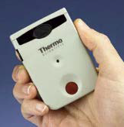
Personnel dosimeters are devices worn by laboratory personnel to monitor radiation doses from external sources.
There are two general types:
Dosimeter badges, which are used to measure cumulative doses over periods of weeks or months, and
Pocket dosimeters, which are generally used for monitoring over a shorter term.

Slide 38
Physical Agents
Heat
Cold
Light
Noise
Vibration
Ultraviolet Radiation
Ionizing Radiation

Slide 39
Environmental stress in the Industrial area due to chemical agents

Slide 40
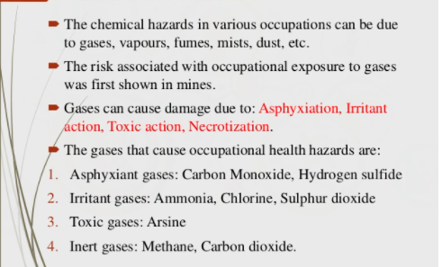
Chemical Hazards

Slide 41
The longest word in English Language

Slide 42
PneumonoultraMicroscopicsilicovolcanoconiosis

Slide 43
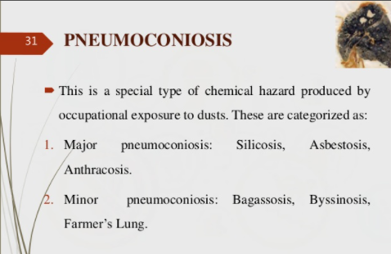

Slide 44
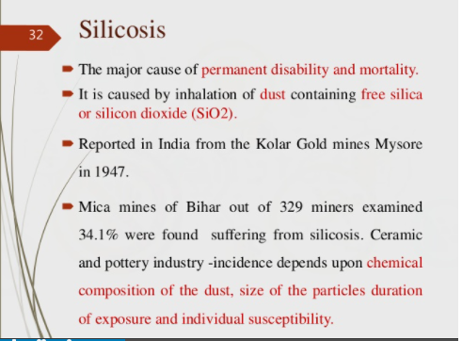

Slide 45
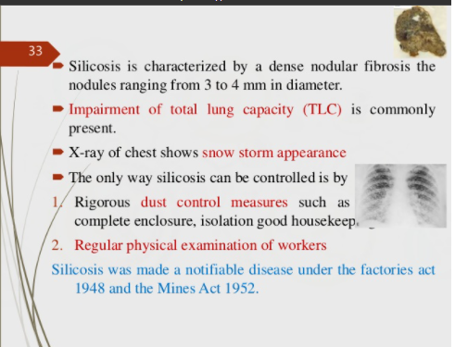

Slide 46
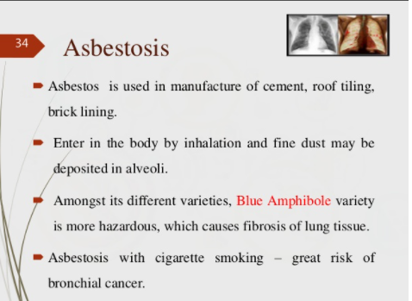

Slide 47
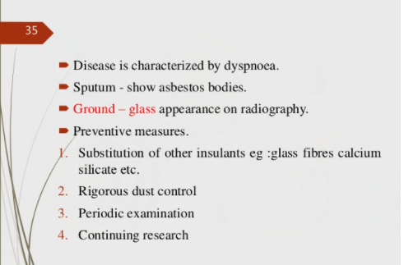
ASBESTOSIS

Slide 48


Slide 49
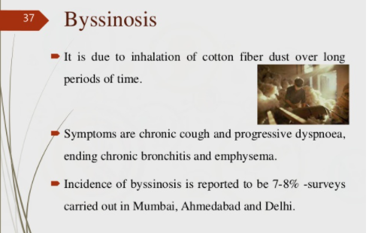

Slide 50
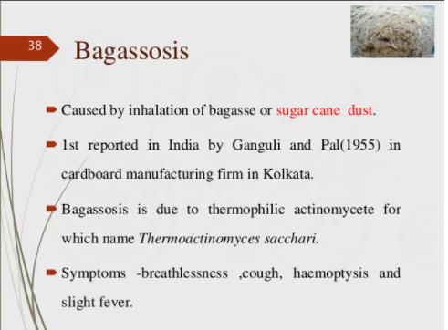

Slide 51
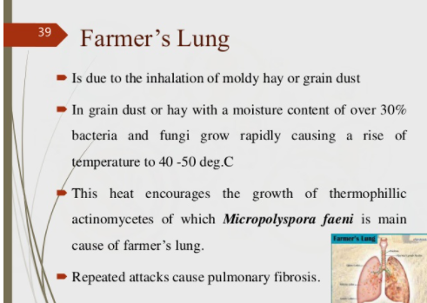

Slide 52


Slide 53
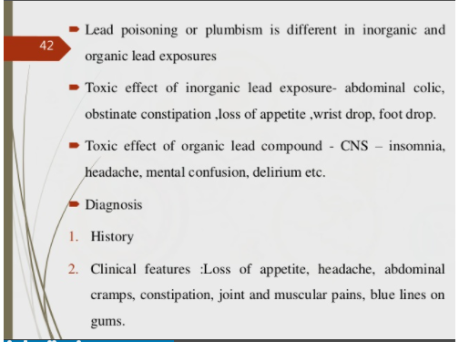

Slide 54
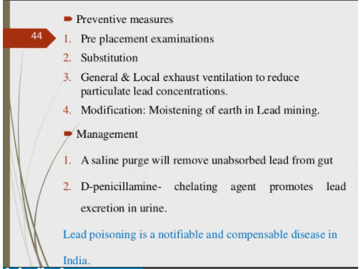

Slide 55


Slide 56
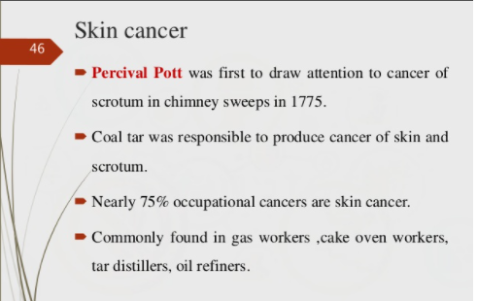

Slide 57


Slide 58
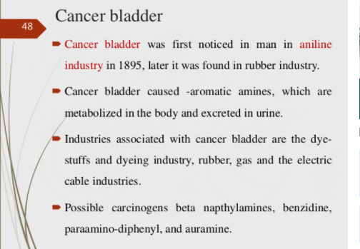

Slide 59


Slide 60
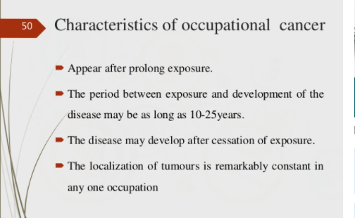

Slide 61
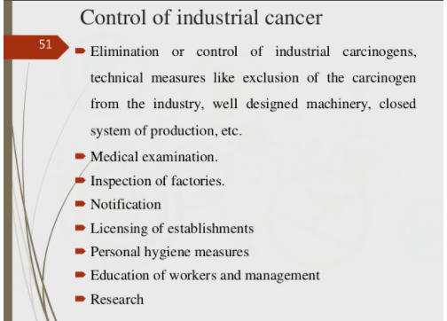

Slide 62
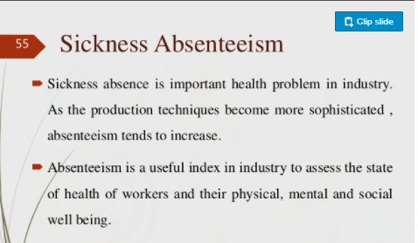

Slide 63
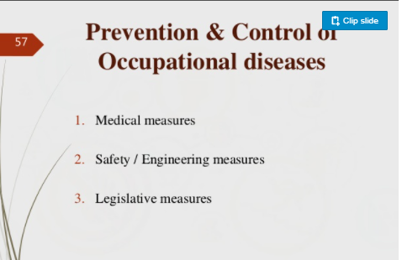

Slide 64


Slide 65
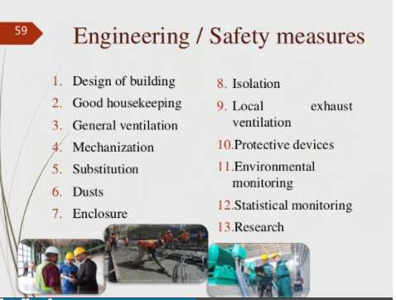

Slide 66


Slide 67


Slide 68


Slide 69


Slide 70
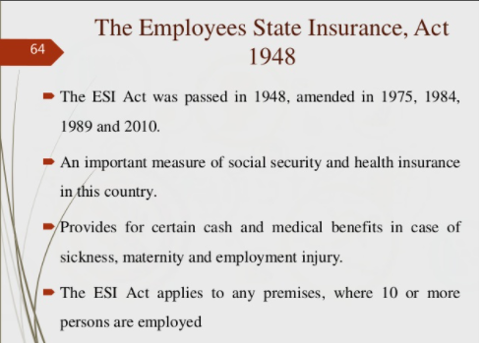

Slide 71
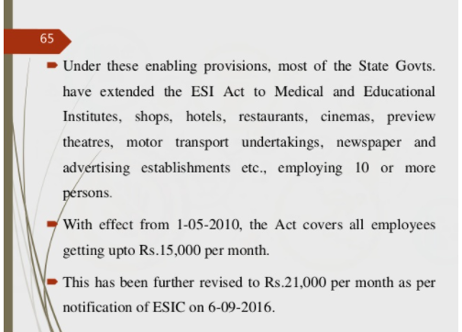

Slide 72


Slide 73


Slide 74


Slide 75
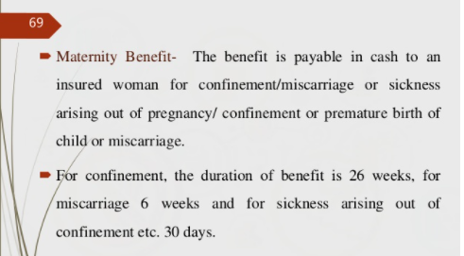

Slide 76


Slide 77


Slide 78


My favorite hideout in the hills

